Slide 1
ENG 346
Data Structures and Algorithms for Artificial Intelligence
Trees
Dr. Mehmet PEKMEZCİ
mpekmezci@gtu.edu.tr
https://github.com/mehmetpekmezci/GTU-ENG-346
ENG-346 Teams code is 0uv7jlm

Slide 2
Agenda
Basic Concepts

Slide 3
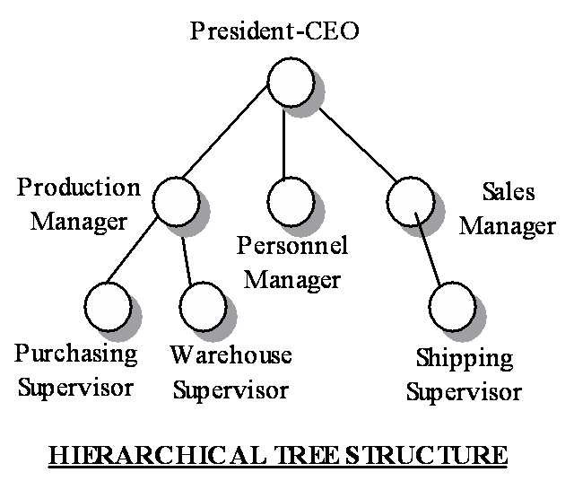
What is a Tree?
A tree is a hierarchical data structure consisting of nodes connected by edges, with a designated root node and branches that form a directed acyclic graph.

Slide 4
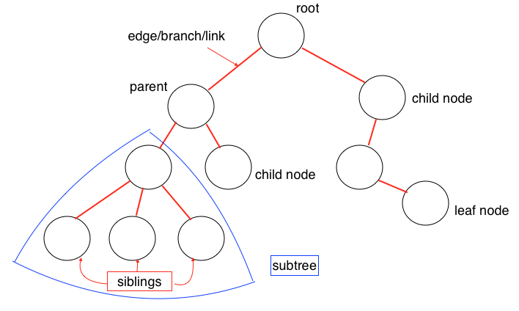
Definitions
Notes:
Node:
A fundamental building block of a tree.
Contains data or information.
May have zero or more child nodes.
Edge:
Connects two nodes, representing a relationship between them.
In a tree, edges depict the hierarchical connection between parent and child nodes.
Root:
The topmost node in a tree.
A tree has exactly one root.
All other nodes are descendants of the root.
Parent:
A node in a tree that has one or more child nodes.
The node directly above a given node is its parent.
Child:
A node in a tree that has a parent node.
Nodes directly beneath a given node are its children.
Leaf:
A node in a tree that has no children (i.e., has a degree of 0).
Located at the "end" of a branch.
Subtree:
A tree formed by a node and its descendants.
Any node in a tree can be considered the root of a subtree.
Depth of a Node:
The length of the path from the root to the node.
The root has a depth of 0.
Height of a Node:
The length of the longest path from the node to a leaf.
Leaves have a height of 0.
Height of a Tree:
The height of the root node, indicating the depth of the deepest node in the tree.
Siblings:
Nodes that share the same parent are called siblings.

Slide 5
Tree Terminology
Root: node without parent (A)
Internal node: node with at least one child (A, B, C, F)
External node (a.k.a. leaf ): node without children (E, I, J, K, G, H, D)
Ancestors of a node: parent, grandparent, grand-grandparent, etc.
Depth of a node: number of ancestors
Height of a tree: maximum depth of any node (3)
Descendant of a node: child, grandchild, grand-grandchild, etc.
Subtree: tree consisting of a node and its descendants
A
subtree
B
C
D
E
F
G
H
I
J
K

Slide 6
Applications of Trees
Organization Charts
Decision Trees in Machine Learning
File Systems
Expression Parsing
DOM Model of Web pages

Slide 7
Tree ADT
We use positions to abstract nodes
Generic methods:
  Integer len()
  Boolean is_empty()
  Iterator positions()
  Iterator iter()
Accessor methods:
  position root()
  position parent(p)
  Iterator children(p)
  Integer num_children(p)
Query methods:
  Boolean is_leaf(p)
  Boolean is_root(p)
Update method:
  element replace (p, o)
Additional update methods may be defined by data structures implementing the Tree ADT

Slide 8
Tree ADT
Assume T is a tree, and p is a position (node of the tree).
Functions/Operations | Description
p.element() | Data stored in p
Accessors
T.root() | Return the position of the root of the tree. None is T is empty.
T.is_root(p) | True if p is the root, False otherwise.
T.parent(p) | Return the parent of position p. None if p is the root.
T.children(p) | Return list of children of position p.
T.num_children(p) | Number of children of position p.
Queries
T.is_leaf(p) | True if position p has no children.
T.is_root(p) | True if position p is the root.

Slide 9
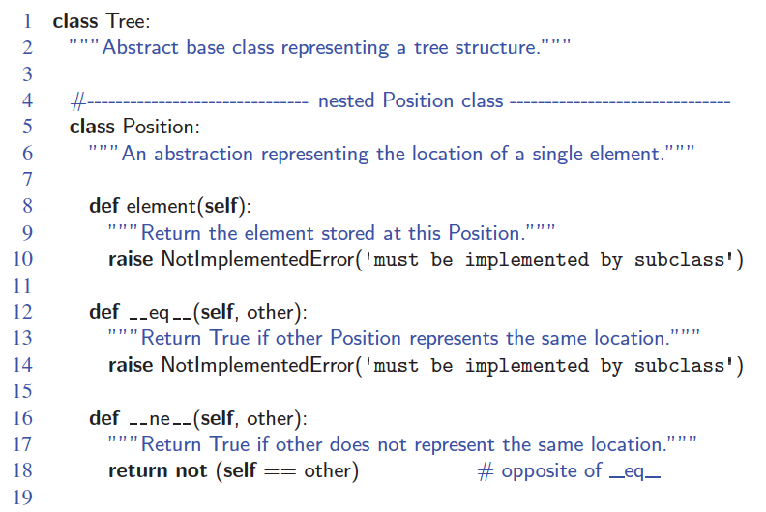
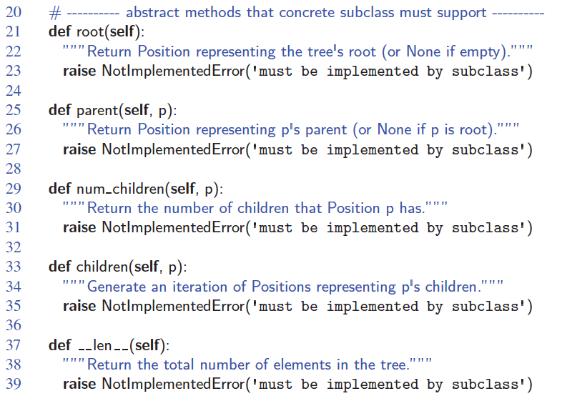
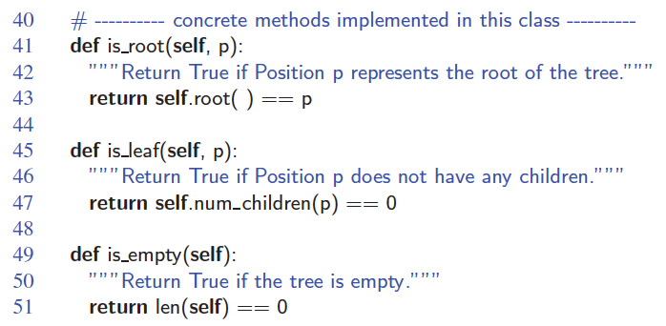
Abstract Tree Class

Slide 10
Binary Trees
A binary tree is a tree with the following properties:
  Each internal node has at most two children
  The children of a node are an ordered pair
The children are called left child and right child
Applications
  arithmetic expressions
  decision processes
  searching
A
B
C
D
E
F
G
H
I

Slide 11
Arithmetic Expression Tree
Binary tree associated with an arithmetic expression
  Internal nodes: operators
  Leaf nodes: operands
Example: arithmetic expression tree for the expression (2 × (a − 1) + (3 × b))
+
×
×
2
−
3
b
a
1

Slide 12
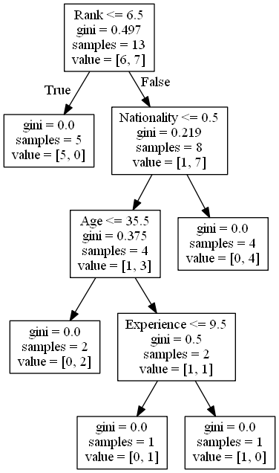
Decision Tree
Binary tree associated with a decision process
  Internal nodes: questions with yes/no answer
  Leaf nodes: decisions

Slide 13
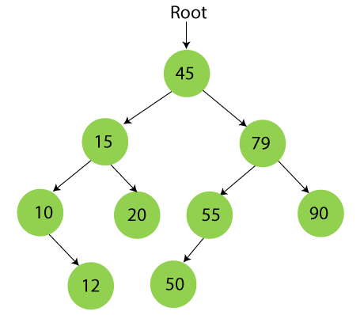
Searching
Binary search tree

Slide 14
Binary Tree ADT
The Binary Tree ADT extends the Tree ADT, i.e., it inherits all the methods of the Tree ADT
Additional methods:
  position left(p)
  position right(p)
  position sibling(p)

Slide 15
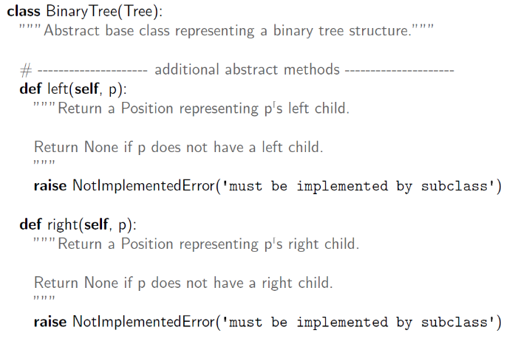
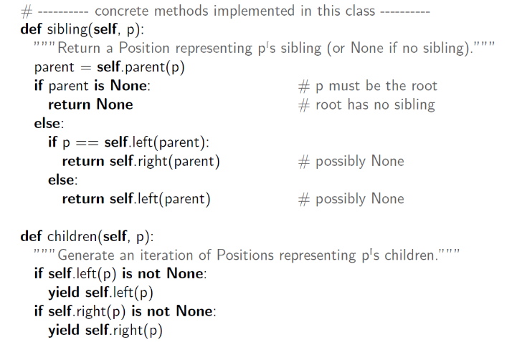
Abstract BinaryTree Class

Slide 16
Preorder Traversal
A traversal visits the nodes of a tree in a systematic manner
In a preorder traversal, a node is visited before its descendants
Application: print a structured document
Algorithm preOrder(v)
visit(v)
for each child w of v
preorder (w)
1
Make Money Fast!
2
5
9
1. Motivations
2. Methods
References
3
4
6
7
8
1.1 Greed
1.2 Avidity
2.1 Stock
Fraud
2.2 Ponzi
Scheme
2.3 Bank
Robbery

Slide 17
Postorder Traversal
In a postorder traversal, a node is visited after its descendants
Application: compute space used by files in a directory and its subdirectories
Algorithm postOrder(v)
for each child w of v
postOrder (w)
visit(v)
9
cs16/
8
3
7
homeworks/
programs/
todo.txt
1K
1
2
4
5
6
h1c.doc
3K
h1nc.doc
2K
DDR.java
10K
Stocks.java
25K
Robot.java
20K

Slide 18
Inorder Traversal
In an inorder traversal a node is visited after its left subtree and before its right subtree
Application: draw a binary tree
  x(v) = inorder rank of v
  y(v) = depth of v
Algorithm inOrder(v)
if v has a left child
inOrder (left (v))
visit(v)
if v has a right child
inOrder (right (v))
6
2
8
1
4
7
9
3
5

Slide 19
Linked Structure for Trees
A node is represented by an object storing
  Element
  Parent node
  Sequence of children nodes
∅
B
∅
∅
B
A
D
F
A
D
F
C
E
∅
∅
C
E

Slide 20
Linked Structure for Binary Trees
A node is represented by an object storing
  Element
  Parent node
  Left child node
  Right child node
∅
B
∅
∅
B
A
D
A
D
∅
∅
∅
∅
C
E
C
E

Slide 21
Binary Search Trees
A Binary Search Tree is a binary tree data structure with the following properties:
  Binary Tree Structure: It is a binary tree, meaning each node has at most two children: a left child and a right child.
  Ordering Property: For every node n, all nodes in its left subtree have values less than n, and all nodes in its right subtree have values greater than n.
This property ensures that the tree maintains a specific ordering, making it suitable for efficient searching.

Slide 22
Tree Traversal
The process of visiting each node in a tree exactly once.
Fundamental for accessing and processing data stored in a tree.
Use cases:
  Search / Data retrieval
  Tree operations (insert, delete, update)
  Serialization / deserialization of a tree
  Backtracking (puzzle, maze solving)

Slide 23
Depth-First Search
Traverse a tree such that the deepest node is visited and then backtrack to its parent node if no sibling of that node exists.
Inorder Traversal
Preorder Traversal
Postorder Traversal
https://www.geeksforgeeks.org/tree-traversals-inorder-preorder-and-postorder/

Slide 24
Application of DFS Algorithm
  For finding the path
  To test if the graph is bipartite
  For finding the strongly connected components of a graph
  For detecting cycles in a graph
https://www.programiz.com/dsa/graph-dfs

Slide 25
Breath-First Search
Traverse a Tree such that all nodes present in the same level are traversed completely before traversing the next level.
Naive solution: find the height of the tree and traversing each level and printing the nodes of that level.
Efficient solution: Use a queue.
  Start at the root node and add it to a queue.
  While the queue is not empty, dequeue a node and visit it.
  Enqueue all of its children (if any) into the queue.
  Repeat steps 2 and 3 until the queue is empty.
https://www.geeksforgeeks.org/level-order-tree-traversal/

Slide 26
BFS Algorithm Applications
  To build index by search index
  For GPS navigation
  Path finding algorithms
  In Ford-Fulkerson algorithm to find maximum flow in a network
  Cycle detection in an undirected graph
  In minimum spanning tree
https://www.programiz.com/dsa/graph-bfs

Slide 27
DFS vs BFS
 | Depth First Search (DFS) | Breadth First Search (BFS)
Data Structure | DFS uses Stack data structure. | BFS uses Queue data structure
Definition | DFS traversal approach in which the traverse begins at the root node and proceeds through the nodes as far as possible until we reach the node with no unvisited nearby nodes. | BFS is a traversal approach in which we first walk through all nodes on the same level before moving on to the next level.
Conceptual Difference | DFS builds the tree sub-tree by sub-tree. | BFS builds the tree level by level.
Approach used | It works on the concept of LIFO (Last In First Out). | It works on the concept of FIFO (First In First Out).
Suitable for | DFS is more suitable when there are solutions away from source. | BFS is more suitable for searching vertices closer to the given source.
Applications | DFS is used in various applications such as acyclic graphs and finding strongly connected components etc. | BFS is used in various applications such as bipartite graphs, shortest paths, etc.

